Slide 1
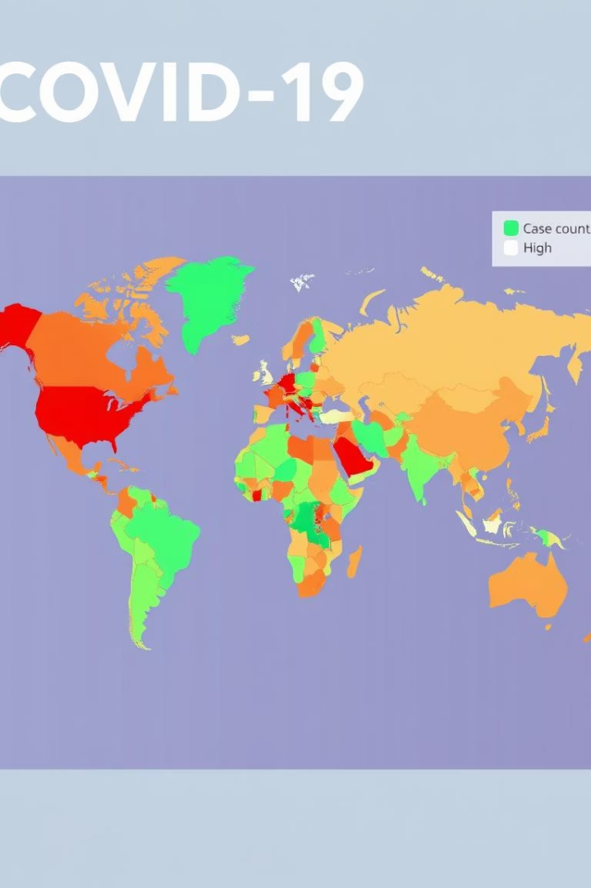

COVID-19 Global Data Analysis Overview
This presentation explores key insights from global COVID-19 data, focusing on case trends, country comparisons, and feature correlations. We analyze confirmed cases, recoveries, deaths, and factors impacting mortality rates worldwide. Visualizations and data-driven findings provide a comprehensive understanding of the pandemic's progression and critical factors influencing outcomes.
by Shubham Raut

Slide 2
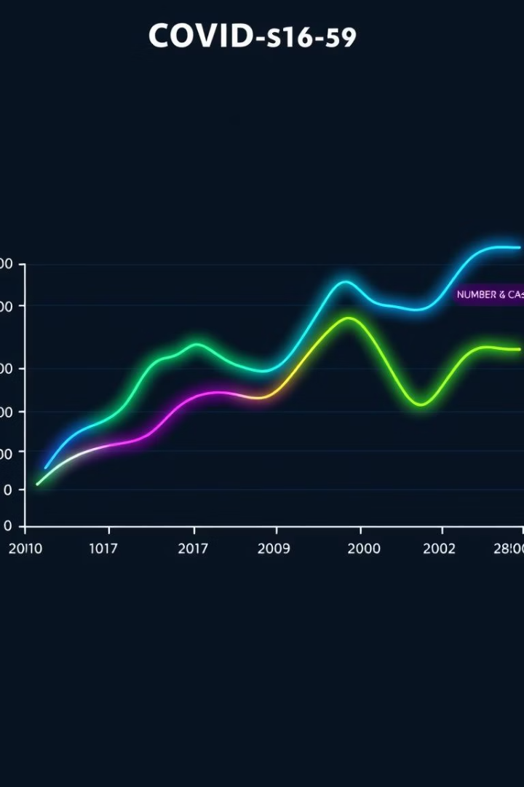
Global COVID-19 Case Trends Over Time
Confirmed Cases
Recoveries
Steady increase in confirmed cases globally, highlighting the pandemic's spread.
Recovery rates have risen alongside cases, indicating treatment progress.
Deaths
Deaths have increased but at a slower pace compared to confirmed cases.

Slide 3
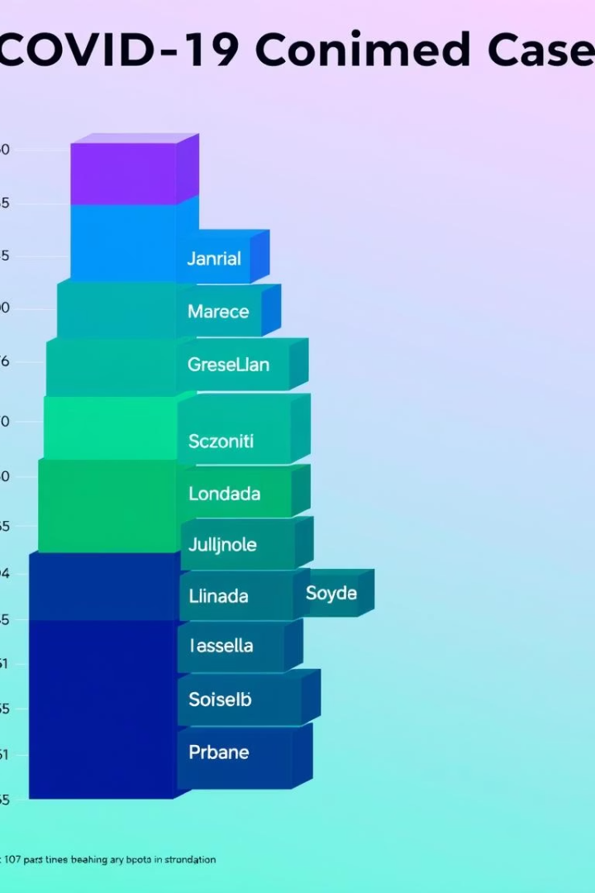
Top 10 Countries by Confirmed COVID-19 Cases
USA
Brazil
Leading with over 5 million confirmed cases, the highest globally.
Second highest with nearly 3 million cases, significant outbreak impact.
India
Rapidly rising cases, exceeding 2 million, showing accelerating spread.

Slide 4
COVID-19 Data Correlation Heatmap
Strong Correlations
Weaker Correlations
Total cases highly correlate with total deaths and recoveries.
Tests per million show low correlation with deaths.
New cases and deaths have moderate correlation, reflecting dynamic trends.
Serious and critical cases closely linked to death counts.

Slide 5
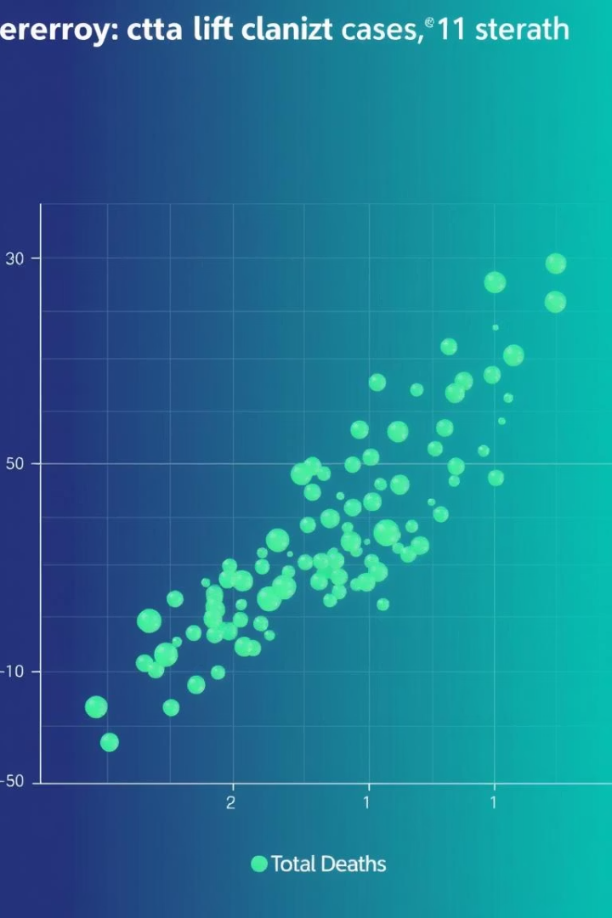



Key Features Impacting COVID-19 Deaths
Serious, Critical Cases
Almost perfect correlation (0.999995) with total deaths, indicating severity drives mortality.
Active Cases
Strong positive correlation (0.897) with deaths, reflecting ongoing disease burden.
Population Size
Moderate correlation (0.435) with deaths, larger populations tend to have more fatalities.

Slide 6
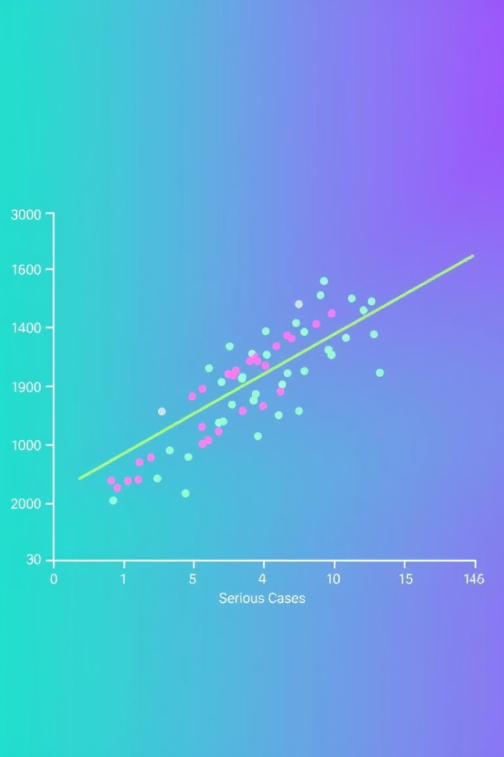
Visualizing Top Correlated Feature vs Deaths
The scatter plot illustrates the nearly perfect linear relationship between serious critical cases and total deaths. This confirms that the severity of cases is the strongest predictor of mortality outcomes across countries.
Understanding this relationship helps prioritize healthcare resources and interventions to reduce fatalities.

Slide 7

Data Preparation and Feature Selection
Data Cleaning
Feature Filtering
Column names standardized and missing values removed for accurate analysis.
Selected key features like Population, Total Cases per million, Deaths per million, and Serious Critical cases.
Correlation Computation
Calculated correlations to identify most impactful variables on death rates.

Slide 8

Summary and Next Steps
Insights
Implications
Serious critical cases and active cases are the strongest predictors of COVID-19 deaths globally.
Targeting severe cases with healthcare resources can reduce mortality rates effectively.
Next Steps
Further analysis on intervention impacts and regional variations to guide policy decisions.

